Slide 1

Airline Travel Capstone Project
TEKsystems Launchpad Program

Slide 2
The overview:
What is the Airline Travel Project?
The creation process!
A quick demonstration of my creation!
Client requirements..
My final thoughts..

Slide 3

Introducing… the Airline Travel Project!

Slide 4
My project in print..
“A client is looking to migrate their analogue flight information system to digital. The client partners with 5 major airlines to enable service to travelers nationwide. There are 6 to 12 hubs nationwide and not all airlines go to all hubs. On a daily basis there are, on average, 30 flights across all airports and utilize a mixture of all airports and airlines. Each flight varies in price based on distance or hub. Assume that each stop along the way adds 45 minutes to the total travel time but reduces price. Add new airlines and associate what airports it serves. Ability to delete airlines. Add new flights and associate which airline the flights are with, as well as the destination and departure airport. Ability to delete flights. Retrieve all flight information. Retrieve all Airport Hub information. Retrieve all Airline information. Flight prices based on distance. Calculate the cheapest or shortest flight between two airports. Retrieve all flight information associated with a specific airline at a specific airport.”

Slide 5


Let the planning begin!!

Slide 6
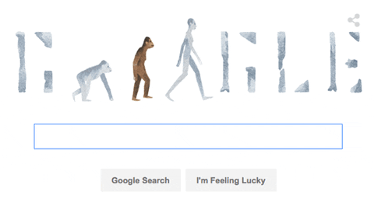
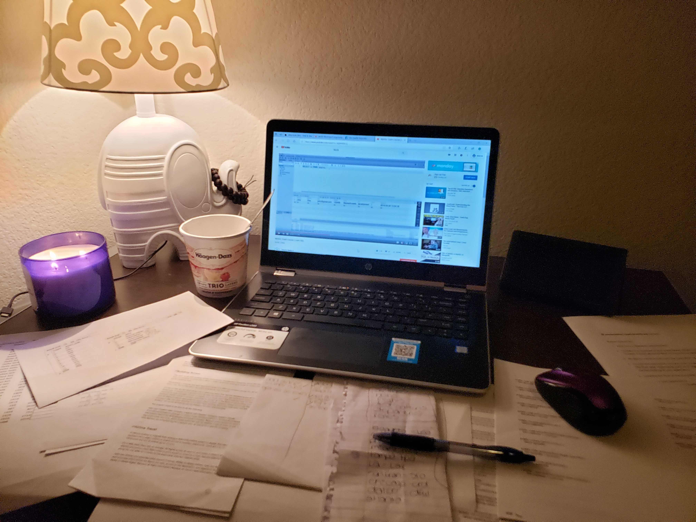
Hour.. after hour.. after hour.. after hour of :

Slide 7

Now for a.. very brief.. demonstration!

Slide 8
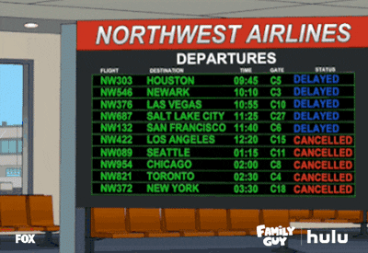
Client Requirements

Slide 9

My final thoughts…

Slide 10

Special shout out to my BCS(orority) for tackling your first project, and to Matt, Natalie and Delphine for helping us get through all of our 404’s/500’s etc!

Slide 11



P.S. Can’t forget the omelettes!

